Slide 1

Foundation of computer science
By : Mohamed Agami

Slide 2

Lecture 13
RAM part 2

Slide 3
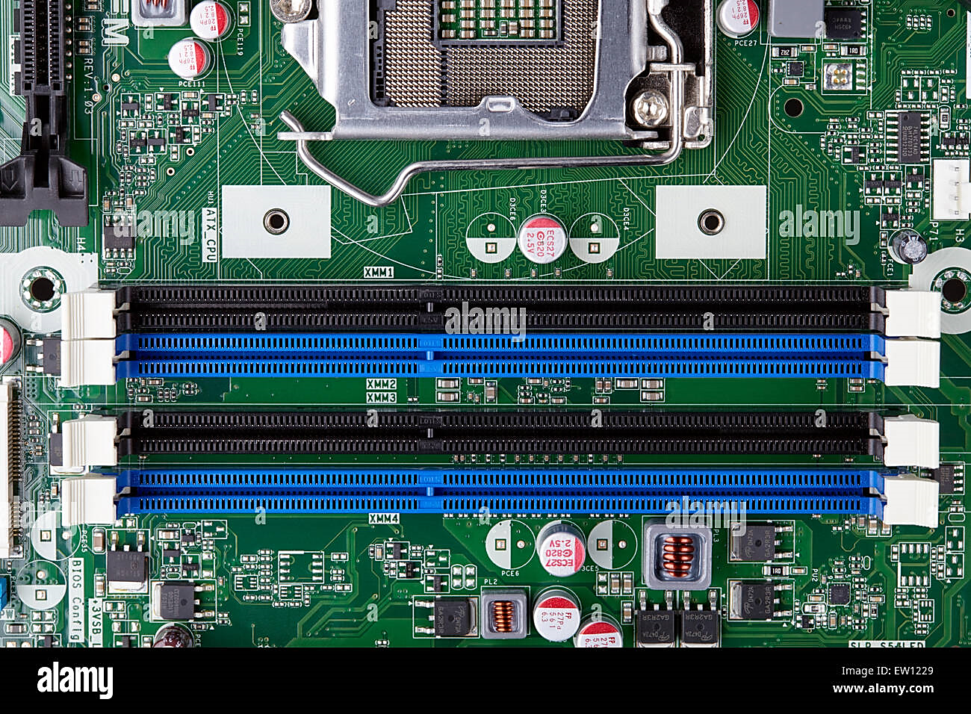
Form factor
Single Channel: One channel, basic performance.
Double Channel: Two channels, improved performance.
Triple Channel: Three channels, further enhanced performance.
Quad Channel: Four channels, maximum performance

Slide 4
Slots Channel
CPU
RAM
Memory Control
RAM
64 bit
64 bit

Slide 5
Slot 1
Chennel 1
B0
Slot 2
B1
Slot 3
Chennel 2
B0
Slot 4
B1

Slide 6
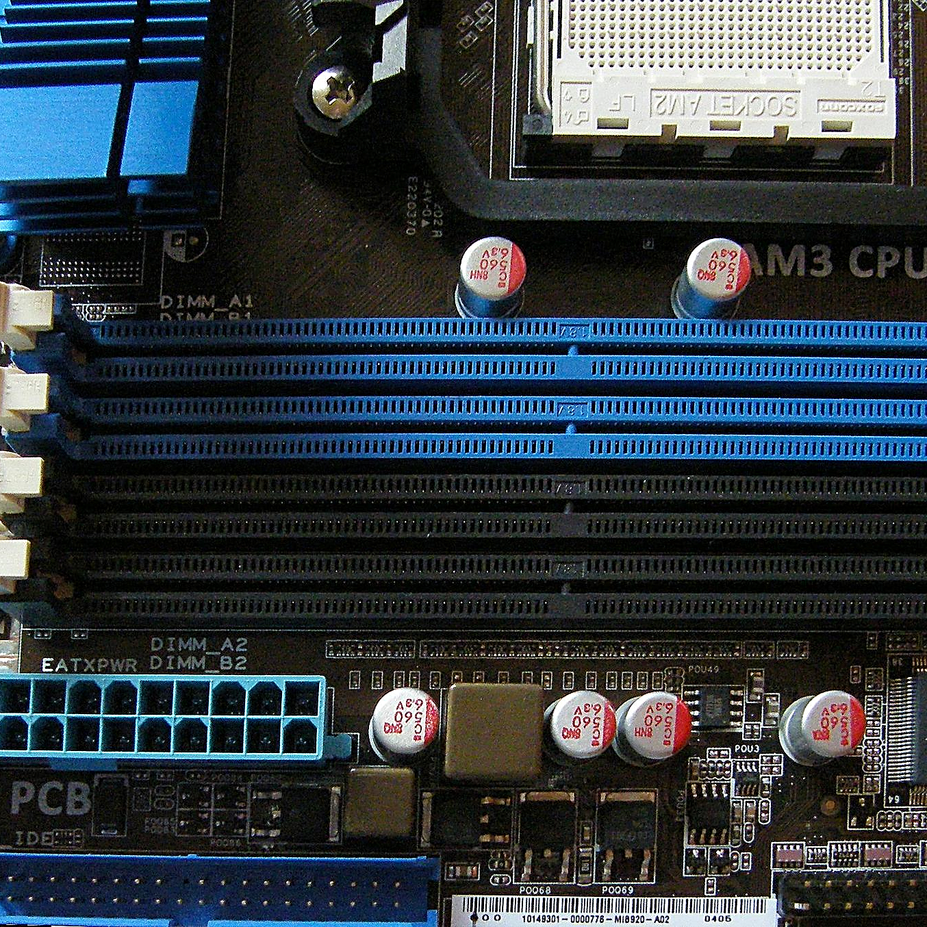

Slide 7
RAM speed and compatibility
When we talk about the memory speed, we need to be aware of the following terms:
Frequency: Measures the speed of steps or the number of cycles per second.
Bandwidth: Measures the amount of data that can be transferred per second and depends on the frequency of several frequencies.

Slide 8
RAM Speed Designation
SDRAM (SDR)
DDR
DDR2
PC -33
PC -66
PC -166
PC -200 BUS * 2
PC -1600 MB
DDR 200
PC -Bandwidth
PC2 - 6400
DDR2 - 800
DDR - Frequency

Slide 9
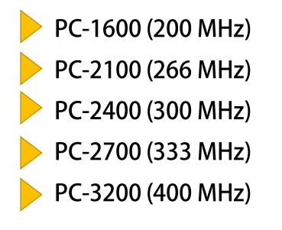
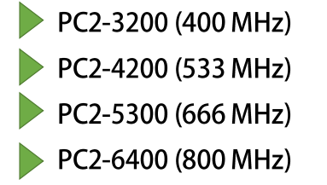
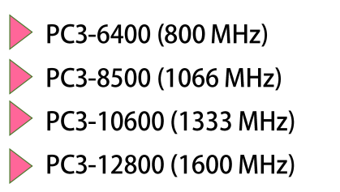
Common RAM Speed
DDR
DDR2
DDR3

Slide 10
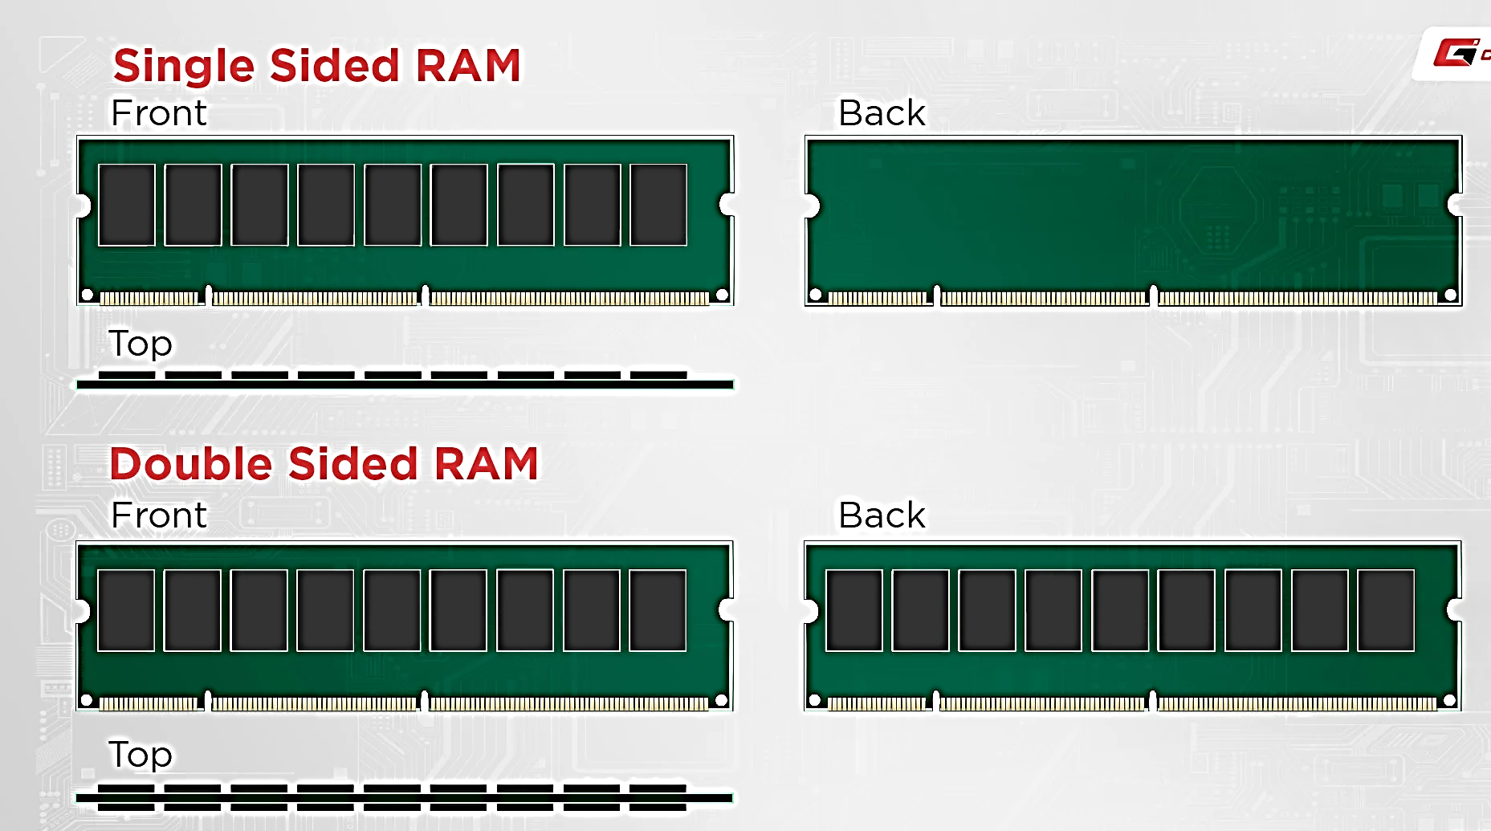
Single side and double side
Single Rank
Double Rank

Slide 11
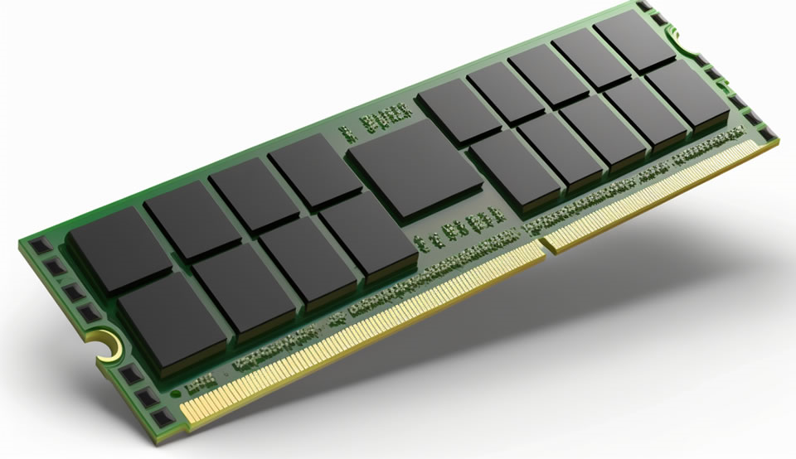
CAS tenancy and RAS latency
CAS (Column Address Strobe)
RAS (Row Address Strobe)
CL16
CL8

Slide 12
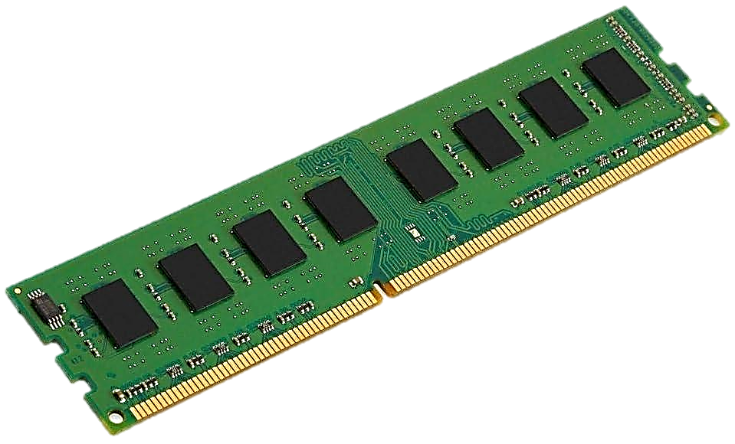
Conclusion
RAM Standard (DDR3, DDR4)
RAM Capacity
RAM Speed
Multi-Channel config

Slide 13

Tank you

